Slide 1
Political Influencers
DSC 104
Austin Le, Chase Oden, Sravya Voleti
Notes:
sravya

Slide 2
Problem
How can we analyze the relationships between legislators based on the events surrounding certain news articles?
We want to query controversial news topics and find legislator tweets surrounding the issue.
Notes:
sravya

Slide 3
Datasets
Political Tweets
Tweets from US legislators.
U.S. Newspaper
US newspaper articles.
Legislators
Information about United States legislators, such as twitter handles, names, party, state, etc.
Notes:
austin

Slide 4
Data Systems
Redis
Will be used as cache to store Solr queries and their results.
Apache Solr
Will act as a search engine to look through US news topics.
Neo4j
View legislator relationship networks.
Express connections between different legislators surrounding newsworthy events.
Notes:
chase

Slide 5
Queries
We wanted to find articles discussing the major issues of 2020: Taxes, COVID19, and the Presidential Election
We used the following keywords to query our Newspaper dataset in Solr
Trump and Taxes
Millions and COVID
Biden and Trump on Election Day
Notes:
austin

Slide 6
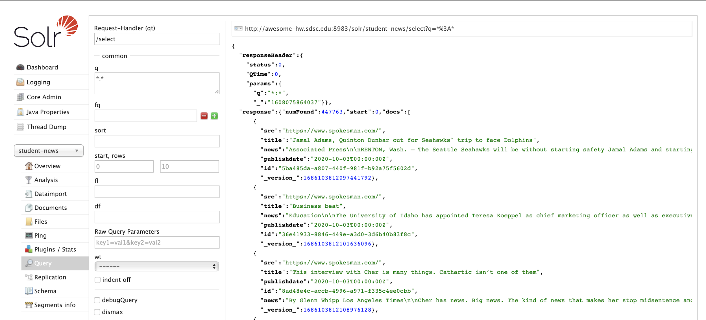
Apache Solr Implementation
link
Used UCSD internal Solr dashboard
Ran queries on subjects that we were looking to explore
Imported Python Requests to get outputs to parse
Solr query dashboard for newspaper dataset
Notes:
austin

Slide 7
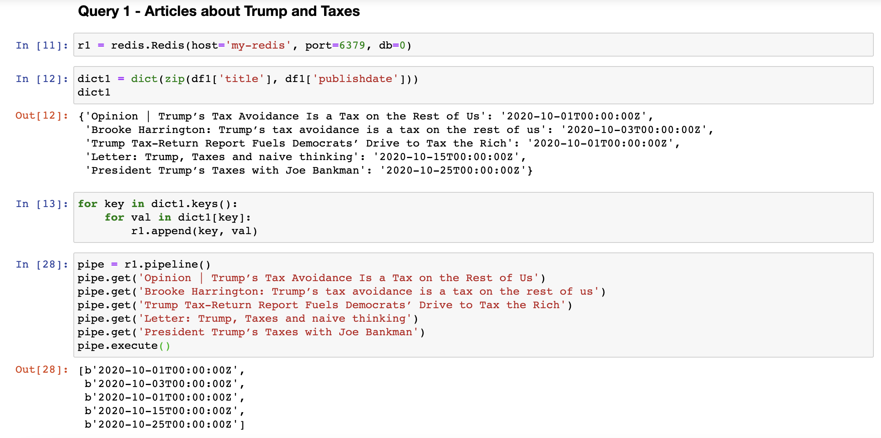
Redis Implementation
Converted outputs of Solr queries into JSON
Created a dataframe for each query
Created a dictionary for the titles of the article (key) and their publish date (value) for each query
Created a Redis pipeline to store each of the three dictionaries
Implementation of Redis Cache for the first query
Notes:
sravya

Slide 8
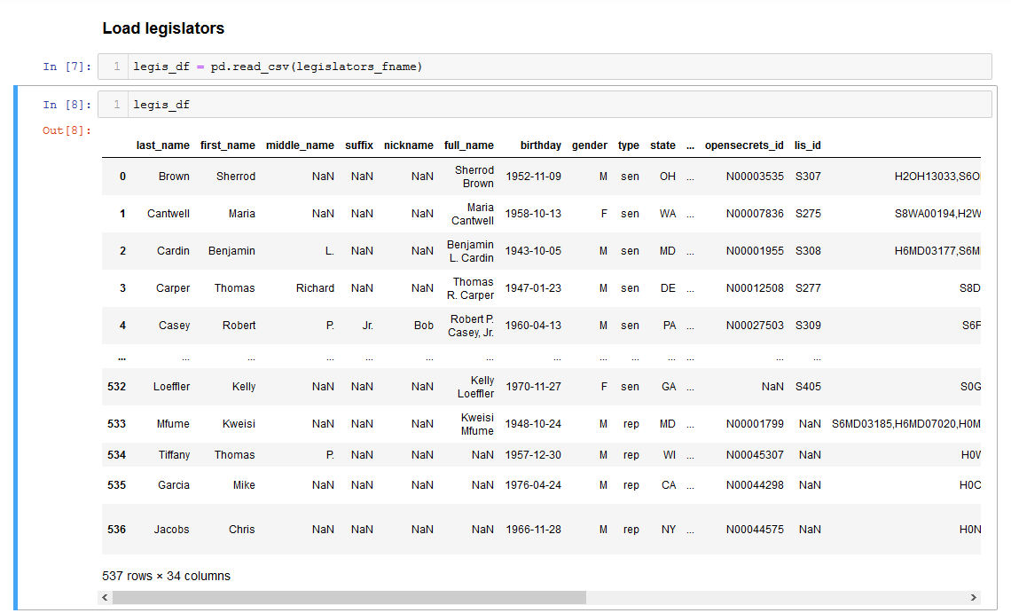
Preparing data for importing into Neo4j
Loaded in legislator data from legislators-current.csv
Fetched unique legislator twitter handles
Created a subset of twitter tweets to reduce file size
Filter out any tweet that doesn’t originate from a legislator’s twitter handle
For our focus on replies, ensure the replied user is also a legislator
Legislator dataset
Notes:
Chase

Slide 9
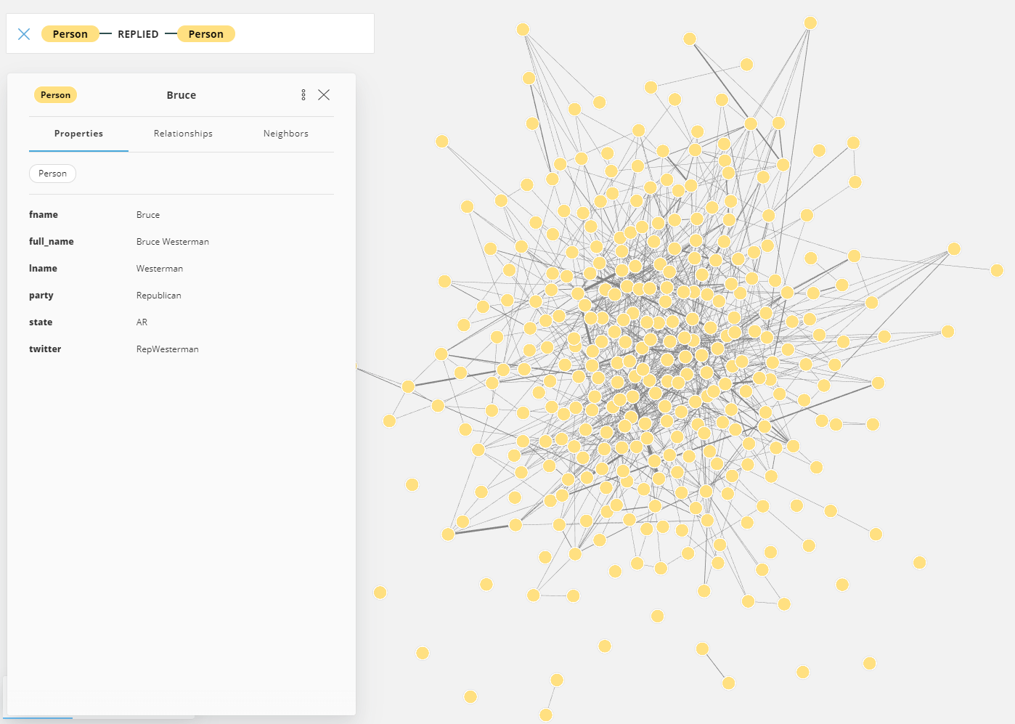
Neo4j
Load the subsetted twitter tweets dataset
Read the csv into neo4j, creating nodes for legislators, who they’re replying to in their tweet, and creating a relationship between the two.
The reply relationship holds the content of the tweet, as well as the date + time the tweet was created.
Neo4j Bloom network showing relationship between legislators through their tweets
Notes:
Chase + Demo here

Slide 10
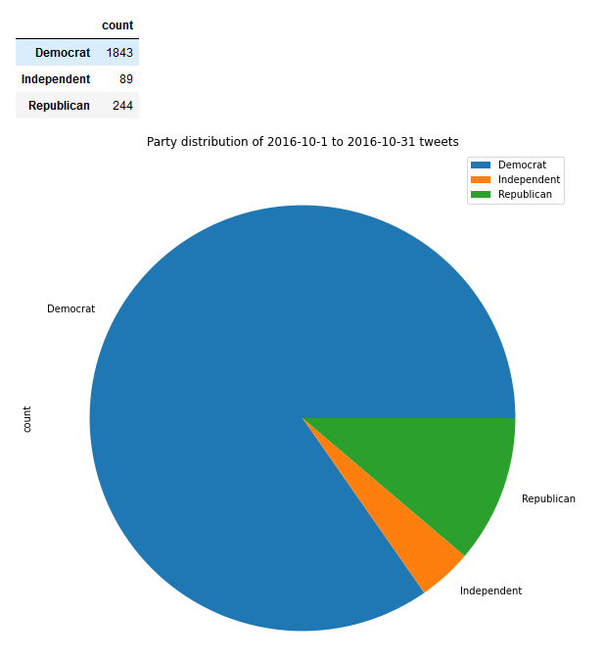
Full Pipeline Analysis
Solr link:
'http://awesome-hw.sdsc.edu:8983/solr/student-news/select?q=title%3Atrump%20AND%20title%3Aelection'
Neo4j query:
MATCH (p1:Person) - [r:REPLIED] -> (p2:Person)
WHERE r.create_date > DATE("2016-10-1") AND r.create_date < DATE("2016-12-30")
RETURN p1, r.text, p2
Party distribution for tweets surrounding the 2016 US presidential election

Slide 11
Thank you for listening!
Questions?
Notes:
Sravya

